Slide 1
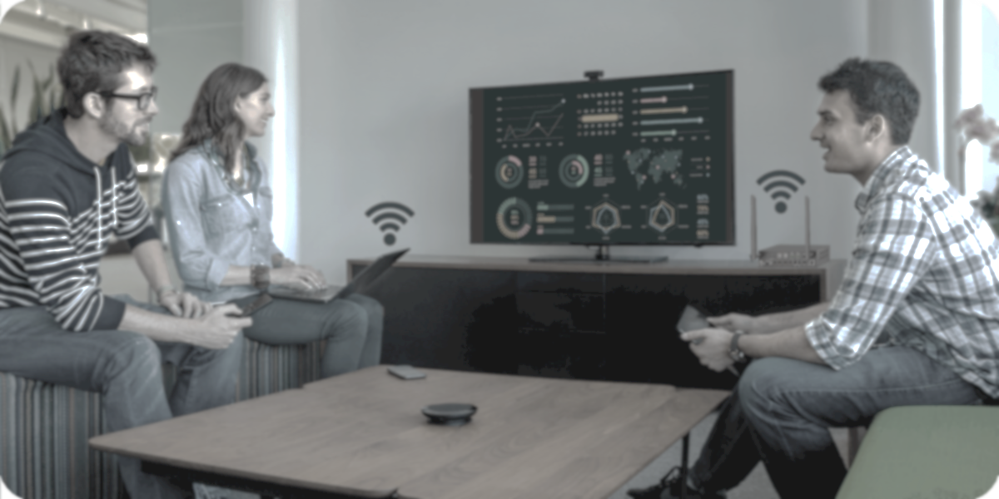
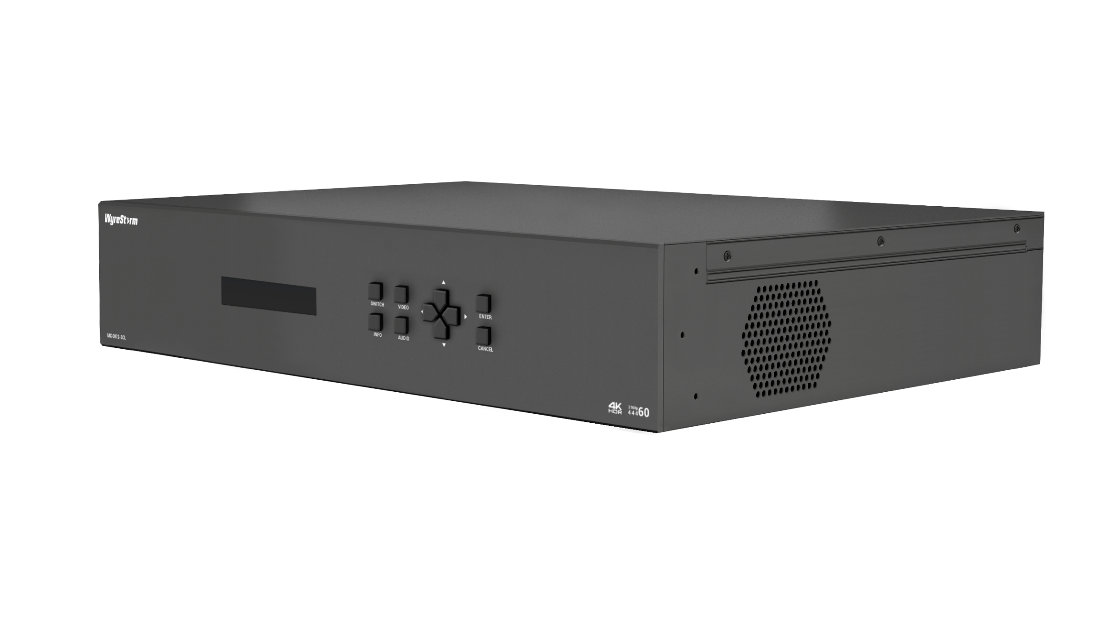

MX-0812-SCL
Product Guide
Advanced 4K HDMI Matrix Switcher
Fast Seamless Matrix with Video Wall Support
Notes:
1. 更新封面，不需要展示产品；

Slide 2

Contents
Product Overview & Main Features
Why Choose Us?
Interface & Specifications
Typical Connection & Applications
Competitor Analysis
Quick Installation Guide & Web UI Introduction
Q & A Session
Powerful · Reliable · Simple

Slide 3
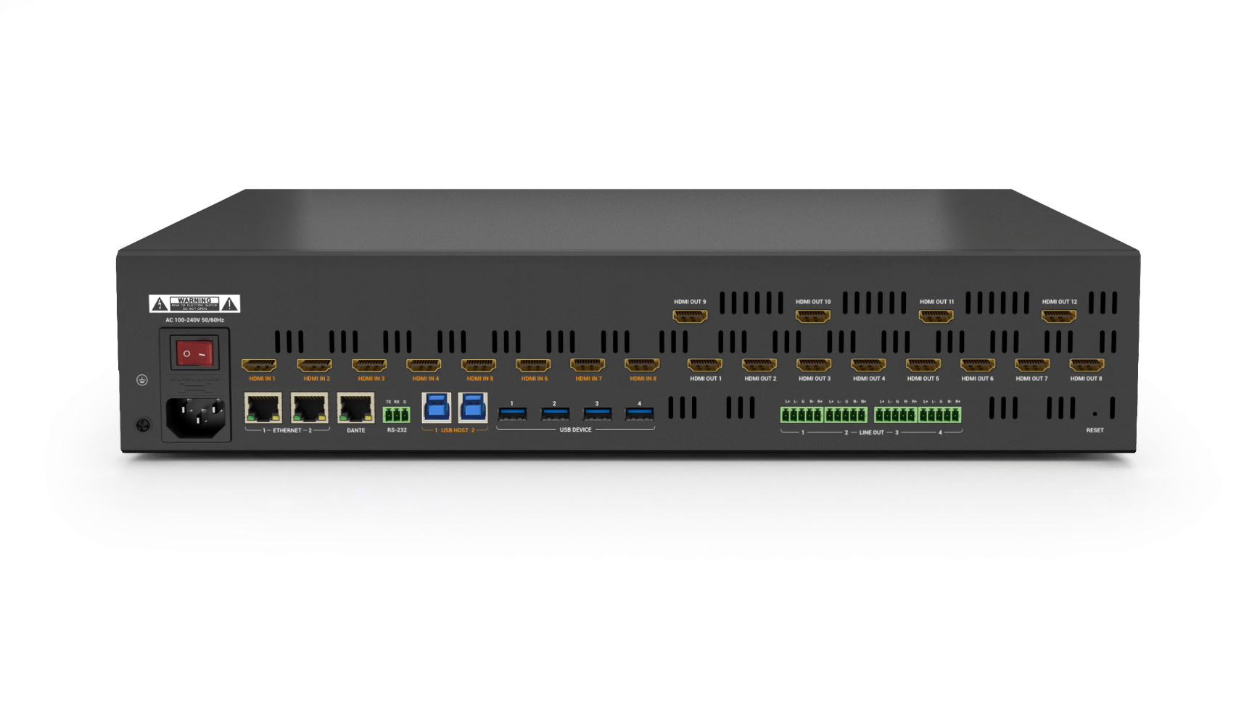
Product Overview
Advanced 4K HDMI Fast Seamless Matrix
The “MX-0812-SCL” is a 4K fast seamless matrix, perfect for auditoriums, lecture halls, and large classrooms. Featuring 8 HDMI inputs and 12 HDMI outputs, it supports up to 4K resolution and enables dynamic splicing video walls. With advanced KVM functionality, it’s ideal for hybrid teaching and meetings. Seamless integration with touch panels or third-party controllers ensures effortless operation across diverse applications. Additionally, it supports Dante transmission, delivering superior audio quality for an enhanced experience.
Powerful · Reliable · Simple

Slide 4








Main Features
Reliable and High-Quality Resolution
Deliver sharp and clear 4K video for a fully immersive presentation experience.
Built-in Dante(4x4) for Audio Transmission
Supporting Dante (4x4) to transmit audio signal, working directly with Dante Audio System, such as Dante audio DSP, Dante Mic, and Dante amplifiers.
Fast Seamless Switching
Eliminate black screens when switching between sources like laptops, PCs, and document cameras.
Balanced Audio De-embedding
Integrate seamlessly with external audio systems for enhanced sound quality. Pair with a professional amplifier, speakers, and microphones to deliver an immersive audio experience for presenters and participants.
Video wall Feature Supporting
Create video walls with up to 12 screens in layouts like 2x2, 3x2, and 3x3.
Support multiple simultaneous video walls (e.g., 3 x [2x2]) and adjust bezels for improved image alignment and edge quality.
Versatile and Flexbile Ethernet
Enhance hybrid meetings and education with reliable networking. Ethernet Bridge and Isolation ensure stability and security.
KVM for Hybrid Teaching & Meetings
Simplify cable management and streamline workflows with USB 3.0 ports for cameras, speakerphones, and keyboards. Designed for hybrid meetings and education, it enables seamless device switching through a single hub.
Centralized Control and Automation
Enable remote monitoring and control via Web-UI, RS232, and Telnet. Access real-time system status, configuration, and performance effortlessly.
Powerful · Reliable · Simple

Slide 5
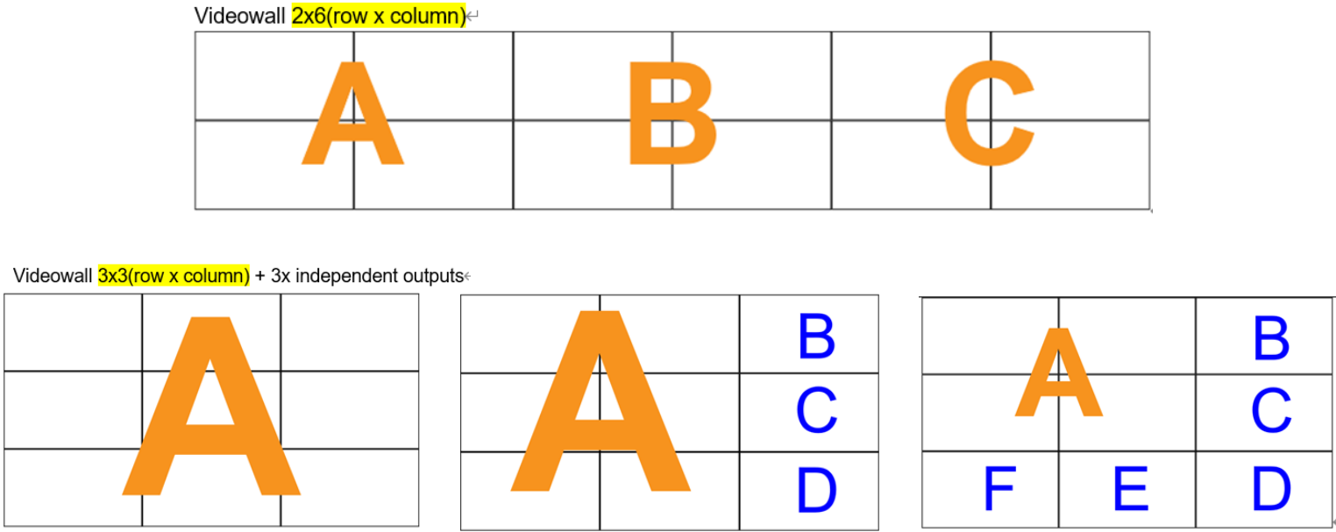
Why Choose Us: 1. Immersive Viewing Experience and Video Wall
Deliver an immersive viewing experience with 4K@60 resolution, seamless switching, and video wall capabilities, ensuring stunning detail and captivating visuals for the audience.
High-Quality Video Performance
Multiple Splicing Layout
Provide high-quality 4K resolution for detailed information on large-format screens, coupled with fast, seamless switching and no black screen to enhance the viewing experience.
Multiple splicing layouts supporting, creating common layouts such as 2x2, 3x2, 4x2, 5x2, 6x2, 3x3, 3x4. And also creating multiple video walls simultaneously (3 x [2x2]), which allows for selecting different input sources.
Picture Adjustment
Bezel adjustment help guests to enhance viewing experience with stunning details.
Powerful · Reliable · Simple

Slide 6
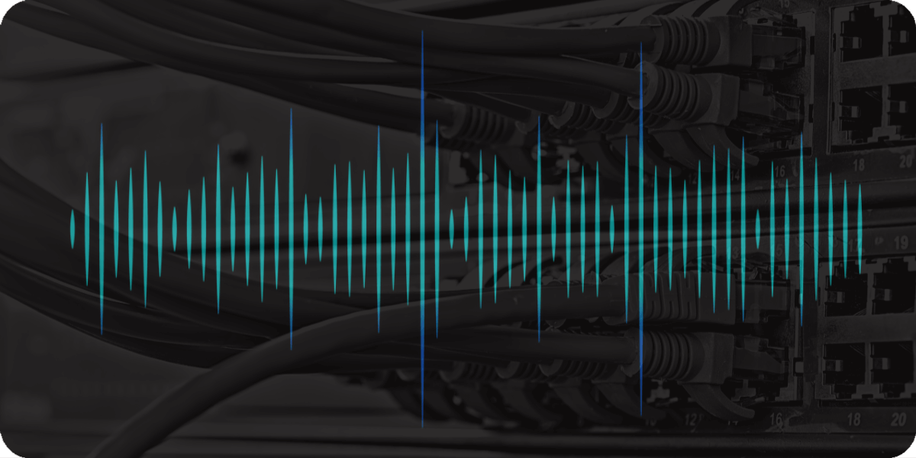
Why Choose Us: 2. Creating Hybrid Working/Teaching Environment
Ensure effortless connectivity, smooth audio performance, and efficient operation in video conferencing, allowing all meeting participants to easily contribute and collaborate productively.
Effortless Connectivity
Smooth Audio Performance
Works flawlessly with cameras, speakerphones, and other USB 3.0 peripherals, delivering a seamless and superior hybrid working experience.
Ensure clear and reliable audio-visual communication by directly working with Dante devices, essential for effective collaboration and decision-making.
Efficient Operation in Hybrid
Enhance the efficiency of hybrid meetings with a user-friendly Web-UI or by integrating with SYN-TOUCH10.
Powerful · Reliable · Simple

Slide 7
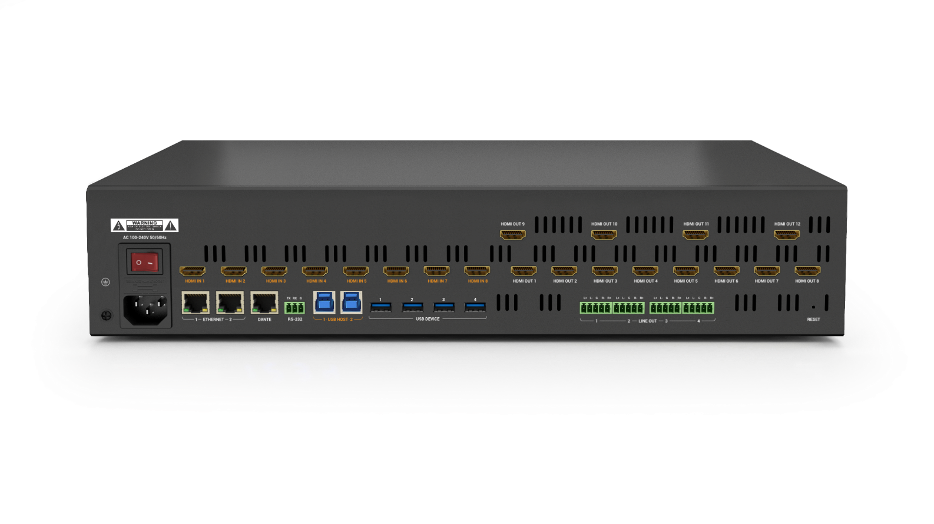
Why Choose Us: 3. Effortless Device Management
Simplify setup with various control methods, making it easy for guests to connect and present without hassle.
Flexible Network Settings
Centralized Control
Provide Ethernet isolation with 2x Ethernet ports for enhanced security and network stability, ideal for separating internal and guest networks.
Manage and monitor all connected devices through an intuitive web interface or all-in-one touchpad controller, simplifying the administration process.
Remote Configuration
Configure the system remotely via SYGMA cloud device management, ensuring that everything runs smoothly without needing to be physically present.
Powerful · Reliable · Simple
Notes:
Centralize and simplify device management to ensure a smooth and efficient operation for all your conferencing needs.

Slide 8
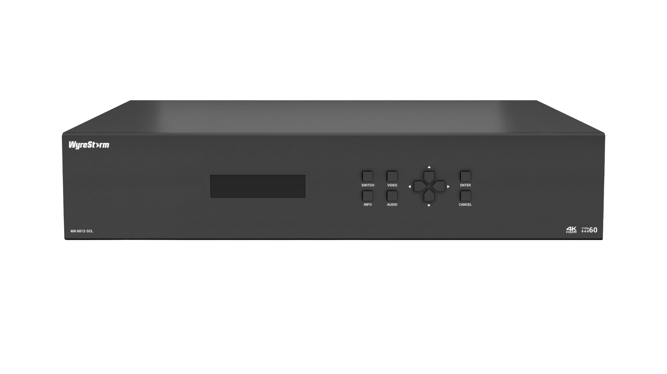
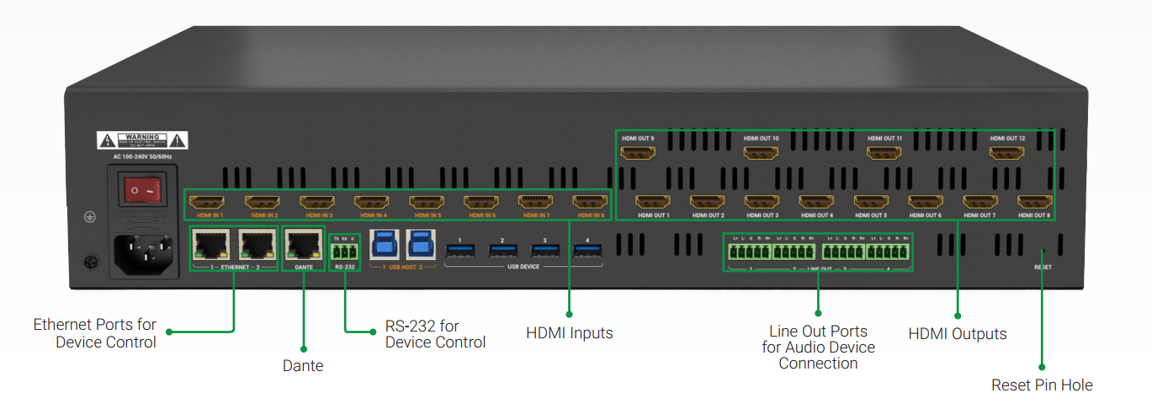
Interface of the Product
Front Panel
Featuring:
HDMI Inputs & Outputs:
Connect to HDMI sources and displays, supporting high-quality resolution video up to 4K@60Hz.
USB Hosts & Devices:
Connect to Web camera, speaker phone, Keyboard and mouse, very useful to share classroom signal with remote students.
3x Ethernet Ports:
One Ethernet port is Dante for audio transmission; Others ensure secure and stable network access for guests using their PCs, while allowing easy configuration of the system via a web interface.
LCD Indicator
INFO, SWITCH, VIDEO AUDIO Button
ENTER, CANCEL Button
Rear Panel

Slide 9
Specifications & Packing List
Main Specifications
Input Video Port | 8x HDMI
Output Video Port | 12x HDMI
Output Video Signal | 4K@60Hz 4:4:4 8bit, HDCP 2.3
Input/Output Resolutions Supported | VESA: 800x600⁸, 1024x768⁸, 1280x768⁸, 1280x800⁸, 1280x960⁸, 1280x1024⁸,1360x768⁸, 1366x768⁸, 1440x900⁸, 1600x900⁸, 1600x1200⁸, 1680x1050⁸,1920x1200⁸ SMPTE: 720x576P⁶, 1280x720P^{6,7,8}, 1920x1080P^{2,5,6,7,8}, 3840x2160^{2,3,5,6,8}, 4096x2160^{2,3,5,6,8 (4:2:0 8bit only)} 2 = at 24 Hz, 3 = at 25 Hz, 5 = at 30 Hz, 6 = at 50 Hz, 7 = at 59.94 Hz, 8 = 60 Hz
Audio Format | HDMI IN/OUT/LINE OUT: PCM 2.0
Control Method | Front panel buttons, RS232, LAN (Telnet API & Web UI)
Power Supply | AC 100~240V 50/60Hz
Power Consumption (Max) | 120W
Dimensions (WxHxD) | 440mm x 88mm x 362mm/17.32” x 3.46” x 14.25”
What’s in the Box?
1x MX-0812-SCL Matrix
1x AC Power Cord (US/UK/EU/AU)
1x 3.5mm 3-Pin Phoenix Male Connector
4x 3.5mm 5-Pin Phoenix Male Connector
2x Mounting Brackets (with Screws)
1x Quick Start Guide
Powerful · Reliable · Simple

Slide 10
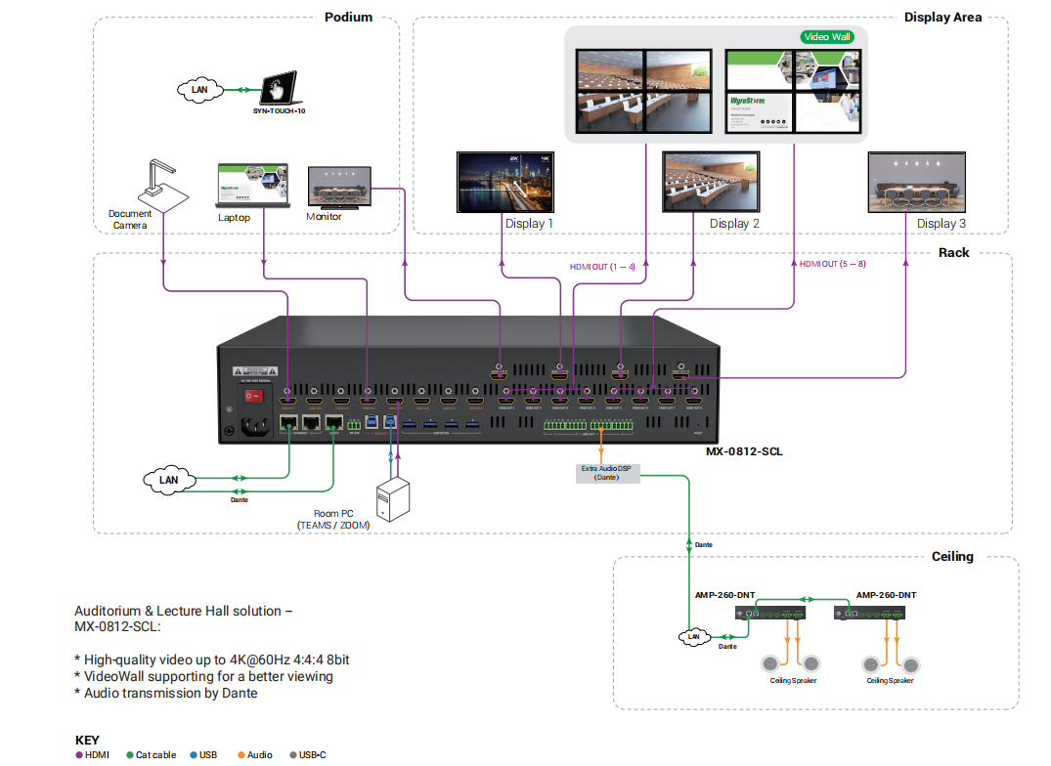
Typical Connection & Applications
Application Scenario 1:
Auditorium & Lecture Hall (Video Wall)
This solution is ideal for auditoriums and lecture halls, connecting video sources to a video wall or displays with the MX-0812-SCL matrix, delivering clear visuals for students. Paired with Dante audio systems and speakers, it ensures high-quality sound to maintain focus. The intuitive touch panel simplifies presentation management, enhancing interactivity and engagement.
Key Benefits Include:
Multiple layout video wall: Create multiple layout video walls, such as two 2x2 setups, to enhance presentation effects.
High-quality viewing experience: Deliver a high-quality viewing experience with up to 4K@60Hz resolution and fast, seamless switching with no black screen.
Provide professional audio performance: Provide professional audio performance by integrating with external audio DSPs, amplifiers, and ceiling speakers.
Dante (4x4): Ensure seamless compatibility with other Dante-enabled devices through built-in Dante (4x4) technology.
Flexible control methods: Simplify system control with flexible options, allowing professors and students to easily manage the entire system using a touch panel.
Notes:
1. fast seamless switching; 这个中间没有“逗号 ‘，‘ “；

Slide 11
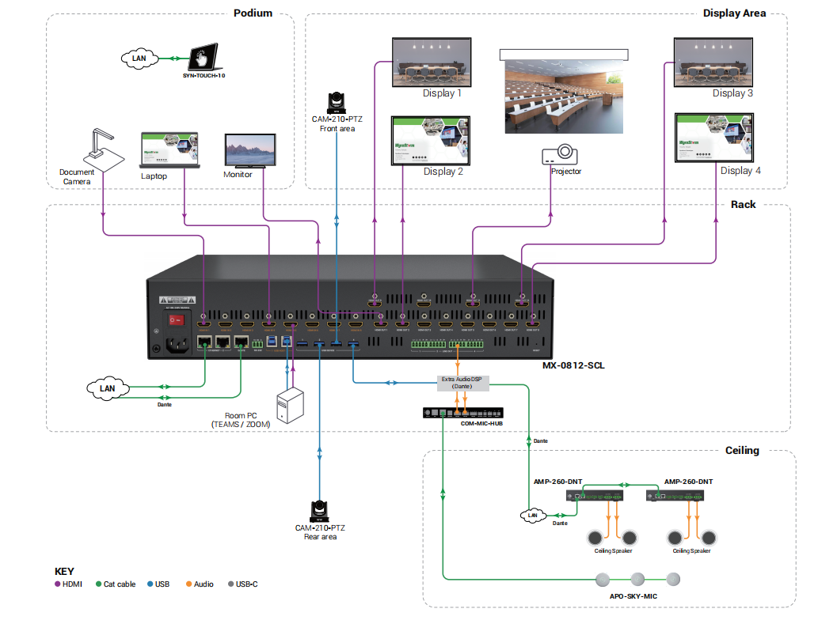
Typical Connection & Applications
Application Scenario 2:
Auditorium & Lecture Hall (Hybrid)
This solution is ideal for hybrid learning in large spaces. The MX-0812-SCL matrix switch connects multiple video sources (laptops, document cameras, in-room PCs) to displays or projectors, delivering clear, vibrant 4K visuals for in-room students. Integrated USB support ensures seamless connection for remote students, providing them with high-quality audio and video. The intuitive touch control panel makes it easy for users to manage the system.
Key Benefits Include:
High-quality viewing experience: Deliver up to 4K@60Hz resolution with fast, seamless switching and no black screen.
Provide professional audio performance: Integrate with external audio DSPs, amplifiers, microphones, and ceiling speakers to enhance the audio experience.
Hybrid teaching & meeting: Connect to camera, audio system, keyboard and mouse, we offer professional hybrid experience.
Dante (4x4): Built-in Dante technology to ensure seamless compatibility with other Dante-enabled devices.
Flexible control methods: Enable control via touch panel, allowing professors and students to easily manage the entire system.

Slide 12
Comparison with Other Competitors
Features | Wyrestorm (MX-0812-SCL) | Kramer (VS-88H2A) | Atlona (AT-HDR-H2H-88MA) | Aten (VM5808HA)
HDMI | 4K@60 444 8bit | 4K@60 444 8bit | 4K@60 420 10bit | 4K@30
HDCP | HDCP 2.3 | HDCP2.2 | HDCP2.2 | HDCP 1.4
Video Wall | Yes, M*N videowall layouts (M,N<=6 and M*N<=12) | No | No | Yes
KVM/USB | KVM Supports/USB3.0 + USB2.0 | No | No | No
Audio Input | Dante | Audio IN | No | No
Audio Output | LINE OUT , Dante OUT | Audio OUT | Audio OUT | No
Audio DSP | No | Yes | No | No
Audio Matrix | 12 x 8 | 24 x 24 | 8 x 8 | 8 x 8
ARC | No | Yes | No | No
Dante | Dante 4*4 | No | No | No
Seamless Switching | Yes | Yes | Yes | Yes
Scaler | Yes | Yes | No | Yes
RS232 | Yes | Yes | Yes | Yes
IR | No | No | Yes | No
Ethernet | 2xLAN | 1xLAN | 1xLAN | 1xLAN
Notes:
Competitor-1: Kramer – VS-88H2A
Competitor-2: Atlona – AT-HDR-H2H-88MA
Competitor-3: Aten – VM5808HA

Slide 13
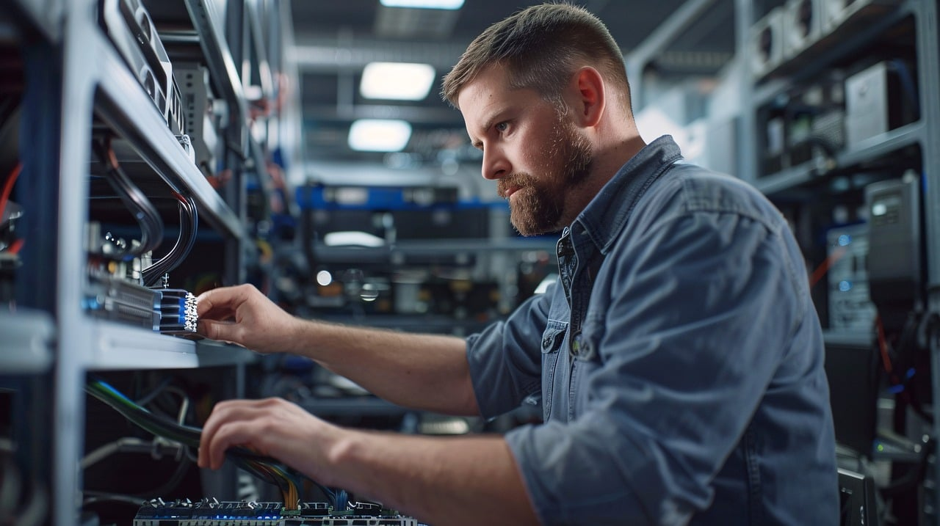
Quick Installation Guide
Effortlessly set up your fast seamless matrix with simple steps, ensuring seamless configuration and an exceptional viewing experience.
Connect Interfaces: Follow the standard product connection guidelines and customize connections based on your environment’s layout for optimal performance.
Start the Device: Use SmartGUI to locate the device's IP address, then log into the Web-UI for easy equipment configuration.
Create Your Video Wall: Create your layout using the Web-UI. For detailed instructions, refer to the user manual.
Enjoy Superior Visuals: Experience stunning video clarity and immersive visuals tailored to your needs.
Powerful · Reliable · Simple

Slide 14
Important Notes for Installation
Ensure all cables are securely connected to avoid performance issues.
Check your network settings and confirm that the device is on the correct subnet.
Double-check configuration settings in the Web-UI to optimize display and functionality.
For complex installations, refer to the documentation or seek professional assistance if necessary.
Powerful · Reliable · Simple

Slide 15
Introduction of Web Configuration Interface
The Web UI of the MX-0812-SCL fast seamless matrix is designed for intuitive device management and control through any web browser. With the Web UI, you can easily configure and customize your videowall setup with the following features:
Web UI Functionality:
Interface: Effortlessly manage device settings via a web browser.
Setting up: Video routing, audio control, and USB settings or design custom video wall layouts.
Control: Set up and adjust video inputs, outputs, and EDID profiles.
Key Web UI Configurations:
General Settings: Configure IP settings, manage security, and perform firmware updates.
Video Inputs/Outputs: Manage HDMI sources, HDCP compliance, and EDID profiles.
Video wall Settings: Easy setting up to create the custom video wall layout.
Control Settings: Enable RS-232 for device control and CEC for display control.
Powerful · Reliable · Simple

Slide 16

Final Thoughts
Q & A Session
Got questions? Don’t hesitate to ask away.
Powerful · Reliable · Simple

